Slide 1
Phase Field Modelling of Solidification

Slide 2
Phase Field Modelling
Phase-field modelling is an efficient solution method for modelling phase transformations.
It has applications in
  Single-crystal solidification
  Directional and polycrystalline solidification
  Grain growth
  Precipitation
Along with that models have now evolved for treating problems on electrochemical reactions, mechanical deformation and fracture processes.

Slide 3
Phase Field Modelling
Phase Field Modelling
Material Science
Numerical Computation
Mathematics

Slide 4
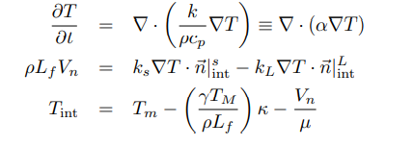
Phase Field Modelling
The classical sharp interface model for isothermal solidification of an alloy is described by :
Solute diffusion in each of the bulk phases
Two boundary conditions at the solid-liquid interface
  flux conservation condition
  Gibbs-Thomson condition
Sharp-interface model / Stefan Problem
The Differential equations are difficult to solve.
The numerical simulation of Stefan Problem is difficult.
Phase field method overcomes these difficulties by describing microstructure with set of field variables.

Slide 5
Phase Field Modelling

Slide 6


Phase Field Variable (f)
Phase Field Variable is a function of space and Time. f(x,t)
f takes value 0 in liquid and 1 in solid phase.
This f creates a continuous field over entire spatial domain of the system.
Main benefit is the interface is not explicitly tracked at every time step in the simulation.

Slide 7
Phase Field Models For Solidification
Single Component System
  Kobayashi Model
Binary Alloys
  WBM Model by Wheeler
  KKS Model by Kim
  Warren and Boettinger

Slide 8



Kobayashi Model
Ginzburg– Landau type free energy functional
Where
ε is the anisotropic gradient energy coefficient which determines the thickness of the interface layer.
The second term is the local free energy which is a double-well potential
The m is the driving force for the interface motion proportional to supercooling.

Slide 9



Kobayashi Model
Allen Cahn equation is given as
The evolution of temperature field, is derived from the conservation law of enthalpy as
K is a dimensionless latent heat which is proportional to the latent heat and inversely proportional to the strength of the cooling

Slide 10

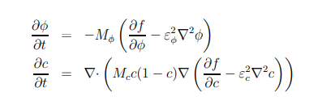
Binary Alloys
Alloy solidification involves both heat and mass transfer. Mass transfer is considered slower than Heat transfer.
Lewis Number (D_{T}/D) is assumed in the range of 100 to 10⁴

Slide 11


Binary Alloy
Free Energy Density Function
function from the free energies of the pure elements
CALPHAD Method

Slide 12



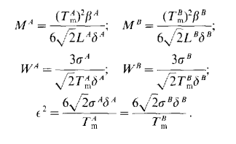

J.A. Warren and W.J. Boettinger Model
W : height of the double well potential gw(φ)

Slide 13
J.A. Warren and W.J. Boettinger Model

Slide 14




Anisotropy
The interfacial anisotropy is introduced by assuming that ε depends on the direction of the outer normal vector at the interface.
. θ₀ is the initial offset angle and taken as a constant

Slide 15

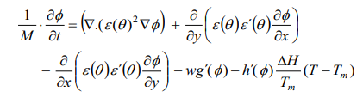
Model Formulation (Pure Melt)
From the work of Kim(1999)
First term is a diffusivity term
Second and third terms represent the anisotropy.
Third term determines the distribution of the excess free-energy at the interface.
The last product on the righthand side represents the driving force behind the solidification process.

Slide 16
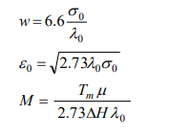
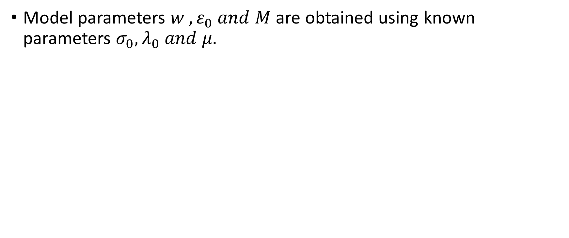
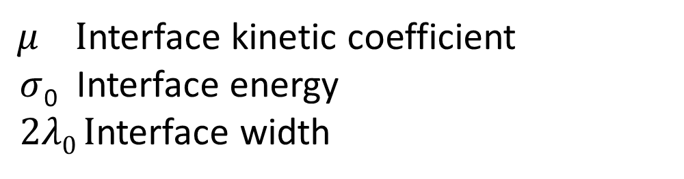
Model Formulation (Pure Melt)
Model parameters $w , ε_{0} and M$are obtained using known parameters $σ_{0}, λ_{0} and μ.$
$μ I$nterface kinetic coefficient
$σ$₀ Interface energy
$2λ0 I$nterface width
Interfacial energy can be obtained experimentally.

Slide 17
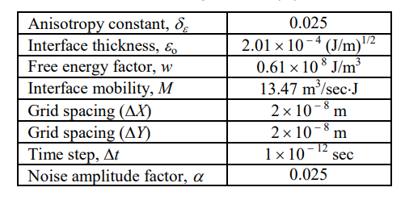
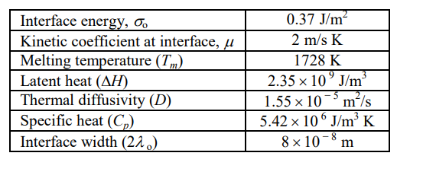

Model Parameter (Pure Ni)
Addition of noise term will induce side branching. This will act as thermal fluctuation.
Selection of grid spacing, time step , interface width is critical.
$$Noise=16 α r φ^{2}{\left(1−φ\right)}^{2}$$

Slide 18



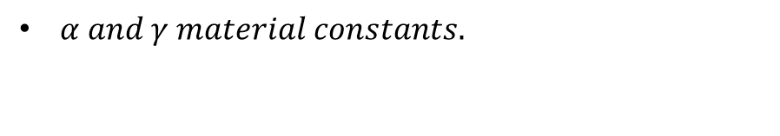
Verification of Kobayashi Model(1993)
Kobayashi presented phase field model for pure melt .
The model verification is done here.
According to Kobayashi model free energy functional is given as:
(m) is parameter which depends on temperature.
$α and γ material constants.$

